Slide 1
Lecture 5.3 Pricing complementary products

Slide 2
Pricing complementary products
Consider what happens if firms can cooperate over complementary products?
Suppose Penelope owns a popcorn stand within Cindy’s Cinema. Consumers purchase movies and popcorn together. The demand for movies and popcorn is given by
Q = 14 − (P_{c} + P_{P}),
P_{c} is the price of a movie, and P_{p} is the price of popcorn.
The marginal cost of popcorn is $2, and the marginal cost of an additional cinema patron is $0.
Cindy and Penelope choose their prices simultaneously. What are the equilibrium prices for Cindy and Penelope? We can see the maximum price of the two goods together must be $14.

Slide 3
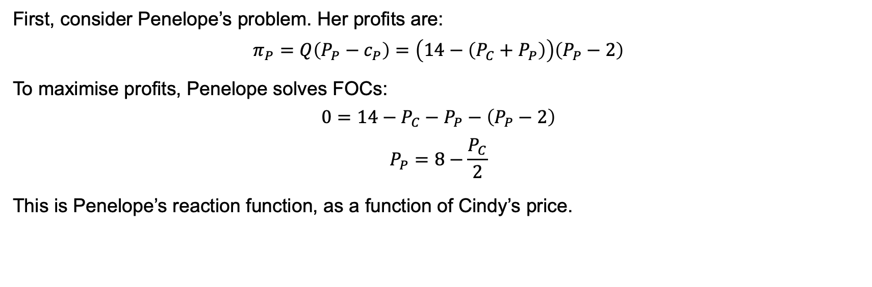
Pricing complementary products
First, consider Penelope’s problem. Her profits are:
$$π_{P}=Q\left(P_{P}−c_{P}\right)=\left(14−\left(P_{C}+P_{P}\right)\right)\left(P_{P}−2\right)$$
To maximise profits, Penelope solves FOCs:
$$0=14−P_{C}−P_{P}−\left(P_{P}−2\right)$$
$$P_{P}=8−\frac{P_{C}}{2}$$
This is Penelope’s reaction function, as a function of Cindy’s price.

Slide 4
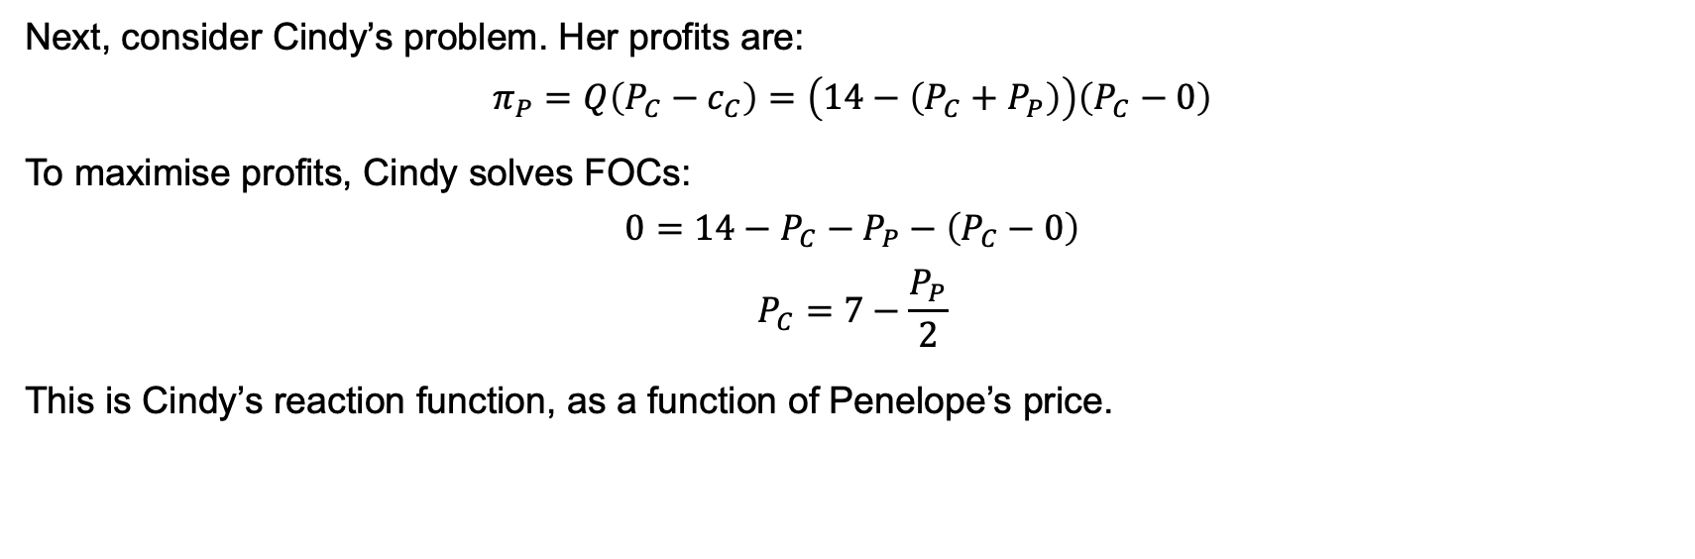
Pricing complementary products
Next, consider Cindy’s problem. Her profits are:
$$π_{P}=Q\left(P_{C}−c_{C}\right)=\left(14−\left(P_{C}+P_{P}\right)\right)\left(P_{C}−0\right)$$
To maximise profits, Cindy solves FOCs:
$$0=14−P_{C}−P_{P}−\left(P_{C}−0\right)$$
$$P_{C}=7−\frac{P_{P}}{2}$$
This is Cindy’s reaction function, as a function of Penelope’s price.

Slide 5
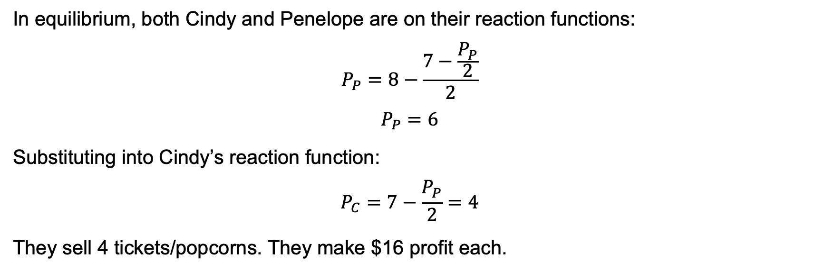
Pricing complementary products
In equilibrium, both Cindy and Penelope are on their reaction functions:
$$P_{P}=8−\frac{7−\frac{P_{P}}{2}}{2}$$
$$P_{P}=6$$
Substituting into Cindy’s reaction function:
$$P_{C}=7−\frac{P_{P}}{2}=4$$
They sell 4 tickets/popcorns. They make $16 profit each.

Slide 6
Pricing complementary products
P_{P}
14
Cindy’s reaction curve
8
P_{P}*= 6
Penelope’s reaction curve
P_{C}
P_{C}*=4
7
16

Slide 7
A Multiproduct firm
An alternative is for Penelope and Cindy to cooperate over the pricing of complementary products
create a joint venture
merge
cooperate (pricing agreements are illegal)
What is the optimal price of the combined product? Why is this different from the case of separate pricing?

Slide 8
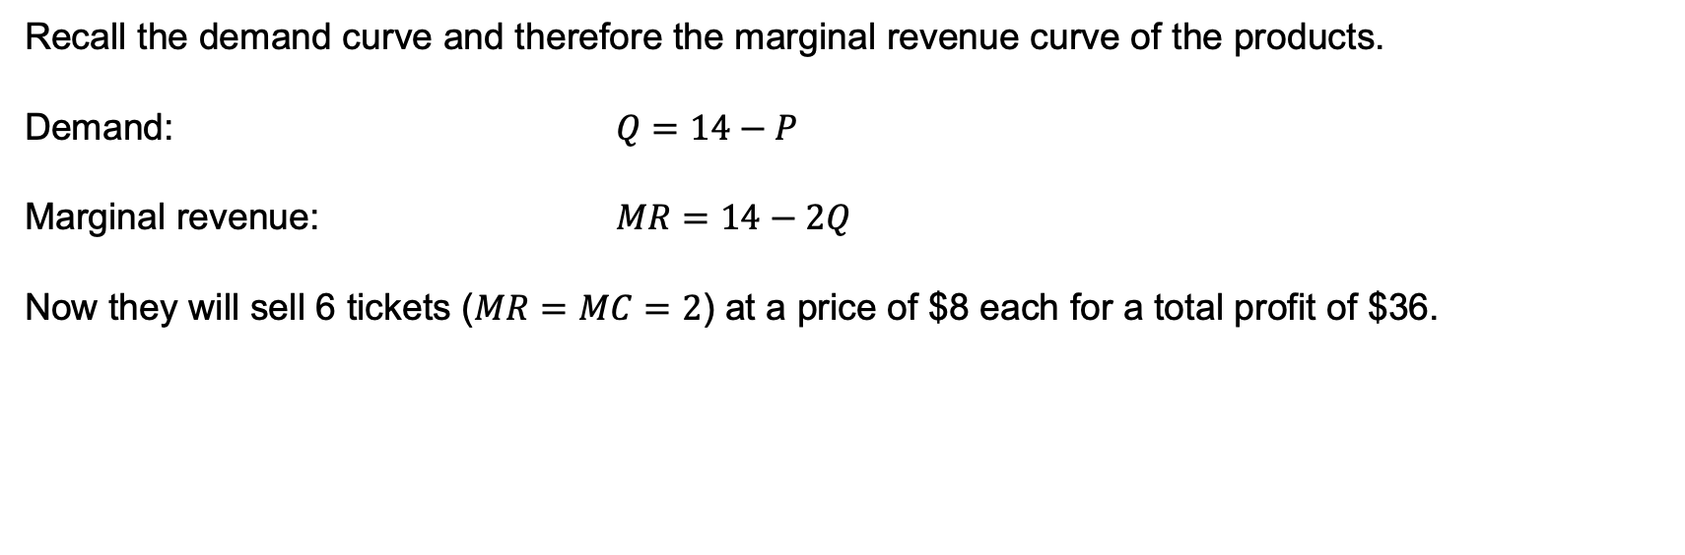
A Multiproduct firm
Recall the demand curve and therefore the marginal revenue curve of the products.
Demand: $Q=14−P$
Marginal revenue: $MR=14−2Q$
Now they will sell 6 tickets ($MR=MC=2$) at a price of $8 each for a total profit of $36.

